Slide 1

Subject Name: High Performance Computing
Module Number: 03
Module Name: Graphics Processing Units

Slide 2
Graphics Processing Units
Syllabus
Graphics Processing Units
Graphics Processing Units : Introduction to Heterogeneous Parallel Computing. GPU architecture. Thread hierarchy. GPU Memory Hierarchy.
GPU Programming: Vector Addition, Matrix Multiplication algorithms. 1D, 2D, and 3D Stencil Operations. Image Processing algorithms, Image Blur, Gray scaling. Histogram Ming, Convolution, Scan, Reduction techniques.
2

Slide 3
Graphics Processing Units
Aim
Graphics processing unit, a specialized processor originally designed to accelerate graphics rendering. GPUs can process many pieces of data simultaneously, making them useful for machine learning, video editing, and gaming applications.
3

Slide 4
Graphics Processing Units
Objectives
The Objectives of this module are
Identify different GPU architecture.
Learn about GPU programming.
Learn about 2D and 3D image processing
Identify Image Processing technique.
4

Slide 5
Graphics Processing Units
Outcome
At the end of this module, you are expected to:
Recognize important GPU architecture and understand working of GPU .
Understand 2D and 3D image Processing
Understand GPU memory hierachy.
Recognize various image processing method
5

Slide 6
Graphics Processing Units
Contents
Introduction to Heterogeneous Parallel Computing.
GPU architecture. Thread hierarchy
GPU Memory Hierarchy.
GPU Programming: Vector Addition, Matrix Multiplication algorithms.
1D, 2D, and 3D Stencil Operations.
Image Processing algorithms – Image Blur, Gray scaling.
Histogram Ming,
Convolution, Scan,
Reduction techniques.
6

Slide 7
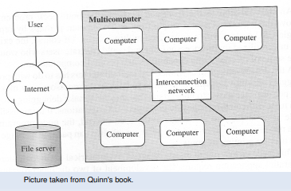
Graphics Processing Units
Introduction to Heterogeneous Parallel Computing:
Concept: Heterogeneous parallel computing involves utilizing different types of processors or computing units to handle various tasks simultaneously. It aims to improve overall computational efficiency by assigning specific tasks to the most suitable processing units.
Types:
CPUs (Central Processing Units)
GPUs (Graphics Processing Units)
TPUs (Tensor Processing Units)
FPGAs (Field-Programmable Gate Arrays)

Slide 8
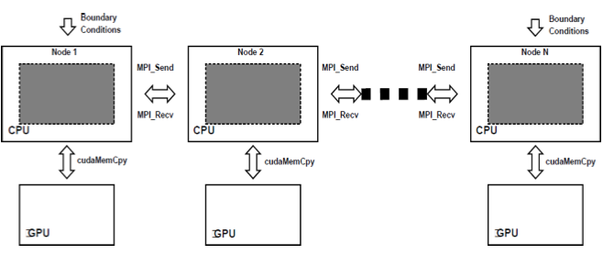
Graphics Processing Units
Graphics Processing Units

Slide 9
Graphics Processing Units
Components Heterogeneous Parallel computing
Processors (CPUs, GPUs, etc.)
CPUs (Central Processing Units) are general-purpose processors handling a wide range of tasks in a computer system.
GPUs (Graphics Processing Units) are specialized processors designed for parallel processing, primarily used in graphics rendering and parallelizable computing tasks.
TPUs (Tensor Processing Units) are specialized accelerators optimized for machine learning tasks, particularly neural networks.
Multi-Layer Perceptrons (MLP)
Convolutional Neural Networks (CNN)
Recurrent Neural Networks (RNN)
2. Memory
Memory refers to the storage space used by a computer to store data temporarily for processing.
Working Concept:
RAM (Random Access Memory) provides fast, volatile storage for actively used data and programs.
Cache memory is a smaller, faster type of memory used to store frequently accessed data for quicker retrieval by the processor.
Storage devices like hard drives and SSDs offer non-volatile, long-term storage for data and programs.

Slide 10
Graphics Processing Units
3. Interconnects (for communication between processors):
Interconnects (for communication between processors):
Interconnects are communication pathways that enable data transfer between different components in a computer system.
Working Concept:
Buses, such as the system bus, connect various hardware components to the CPU, facilitating data exchange.
High-speed interconnects, like PCIe (Peripheral Component Interconnect Express), enable communication between the CPU and peripheral devices.
In multi-processor systems, interconnects (e.g., HyperTransport, NVLink) allow processors to share data and work collaboratively.

Slide 11
Graphics Processing Units
Advantages and Disadvantages Heterogeneous Parallel computing
Advantages
Efficient utilization of specialized processors.
Improved performance for parallelizable tasks.
Flexibility in handling diverse workloads.
Disadvantages:
Complex programming models.
Potential increased power consumption.

Slide 12
Graphics Processing Units
GPU Architecture:
Types of GPU
Integrated Graphics
Discrete Graphics
Mobile GPUs
Workstation and Server GPUs

Slide 13
Graphics Processing Units
Components of GPU Architecture
Streaming Multiprocessors (SMs):-
Processing Cores (CUDA cores or Stream Processors)
Thread Hierarchy
Memory Hierarchy

Slide 14
Graphics Processing Units
Advantages and Disadvantages:
Advantages:
High parallel processing capabilities.
Specialized units for graphics rendering.
Suitable for scientific computing, AI, and machine learning.
Disadvantages:
Complex programming models.
High power consumption for high-performance GPUs.

Slide 15
Graphics Processing Units
Streaming Multiprocessors (SMs):-
A stream multiprocessor is a type of SIMD or a MIMD machine where the constituent processors are streaming processors (SPs) or thread processors. A stream processor is defined as a processor that deals with data streams, and its instruction set architecture (ISA) contains kernels to process these streams
How many threads does a streaming multiprocessor have?
In general an SM can handle multiple thread blocks at the same time. An SM may contain up to 8 thread blocks in total. A thread ID is assigned to a thread by its respective SM.

Slide 16
Graphics Processing Units
Working of Streaming Multiprocessors (SMs):
Handling Multiple Thread Blocks:
In NVIDIA's GPU architecture, each SM can handle multiple thread blocks concurrently.
The ability to process multiple thread blocks simultaneously is a key feature of parallel execution on GPUs, enhancing throughput and efficiency.
Maximum Number of Thread Blocks:
The maximum number of thread blocks an SM can handle concurrently depends on the specific GPU architecture.
As of my last knowledge update in January 2022, the maximum number of active thread blocks per SM is typically in the range of 16 to 32.
Thread ID Assignment:
Each thread within a thread block is assigned a unique thread ID by its respective SM.
Thread IDs are crucial for identifying and coordinating individual threads during parallel execution.
Concurrency:
Multiple thread blocks within an SM can execute concurrently, which is essential for maximizing the parallel processing capabilities of the GPU.

Slide 17
Graphics Processing Units
Working of Streaming Multiprocessors (SMs):
SMs are the heart of a GPU.
Each GPU contains multiple SMs, which are individual processing units responsible for executing tasks in parallel.
SMs consist of ALUs (Arithmetic Logic Units) and control units, allowing them to perform mathematical operations simultaneously

Slide 18
Graphics Processing Units
Graphics Processing Units
Example:
For instance, in NVIDIA's CUDA architecture, an SM might be able to handle, for example, 32 concurrent thread blocks, each comprising a certain number of threads. The exact numbers can vary based on the GPU model and architecture.
Advantages:
Increased parallelism: Multiple thread blocks can be processed simultaneously, enhancing overall throughput.
Efficient resource utilization: Allows the GPU to efficiently manage and execute diverse workloads concurrently.
Disadvantages:
Increased complexity: Coordinating the execution of multiple thread blocks requires careful programming to avoid race conditions and ensure proper synchronization.
Resource constraints: The total number of thread blocks that can be accommodated is limited by the specific GPU architecture.

Slide 19
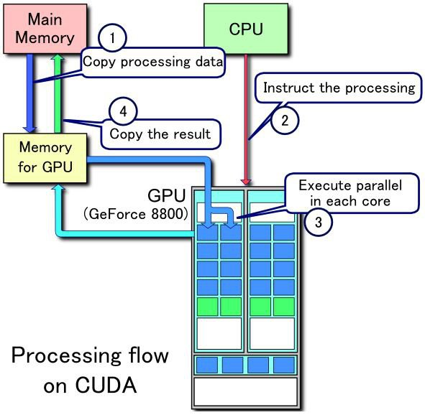
Graphics Processing Units
Processing Cores (CUDA cores or Stream Processors)

Slide 20
Graphics Processing Units
What are CUDA processing cores?
CUDA cores are parallel processors in Nvidia's GPUs that perform computations. They are designed to handle multiple tasks simultaneously, making them ideal for applications that require high computational power, such as gaming, machine learning, and AI

Slide 21
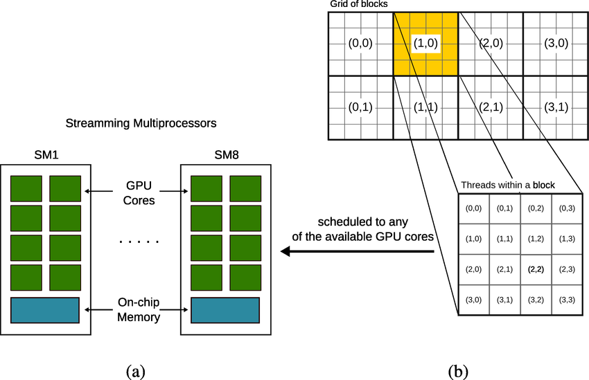
Graphics Processing Units
CUDA Core Working Flow

Slide 22
Graphics Processing Units
Graphics Processing Units
Definition:
CUDA cores, also known as streaming processors or CUDA processing units, are the individual processing units within a GPU that perform parallel computations. These cores are responsible for executing parallel threads concurrently, enabling the GPU to process massive amounts of data in parallel.
OR
CUDA cores can be defined as a parallel computing platform and application programming interface (API) model created by Nvidia, to handle multiple tasks simultaneously, making them highly efficient for jobs that can be broken down into parallel processes

Slide 23
Graphics Processing Units
Functionality: and Architecture:
Architecture:
Parallel Processing Units:
CUDA cores are organized into parallel processing units, each capable of executing a thread independently.
SIMT Architecture:
NVIDIA GPUs use the Single Instruction, Multiple Threads (SIMT) architecture, where each CUDA core processes multiple threads simultaneously.
Functionality:
Parallel Execution:
CUDA cores excel at parallel execution, allowing them to perform multiple calculations simultaneously
Task Division:
CUDA cores divide the workload into smaller tasks that can be executed concurrently, optimizing throughput.

Slide 24
Graphics Processing Units
CUDA Cores vs. CPU Cores:
Specialization:
While CPU cores are designed for general-purpose computing, CUDA cores are specialized for parallel computing tasks, particularly in graphics and scientific computing.
High Throughput:
CUDA cores are optimized for high-throughput parallel processing, making GPUs suitable for tasks that involve processing large datasets concurrently.

Slide 25
Graphics Processing Units
Advantage and Disadvantage of CUDA Core
Advantages:
Parallel Processing Power:
CUDA cores provide significant parallel processing power, making GPUs suitable for tasks like graphics rendering, scientific simulations, and machine learning.
Optimized for Graphics:
Originally designed for graphics rendering, CUDA cores are well-suited for parallelizable tasks in graphics applications.
Disadvantages:
Specialized Use Cases:
CUDA cores are optimized for specific parallel workloads, and their efficiency may vary for general-purpose computing tasks.
Programming Complexity:
Writing efficient CUDA code requires an understanding of parallel programming concepts, which can be complex.

Slide 26
Graphics Processing Units
Advantage and Disadvantage of CUDA Core
Example:
Suppose you are performing a matrix multiplication using CUDA. Each CUDA core could be responsible for calculating a specific element in the resulting matrix. As the matrix is split into smaller tasks, CUDA cores handle these tasks concurrently, speeding up the overall computation compared to a sequential approach.

Slide 27
Graphics Processing Units
Assignment
Explain Heterogeneous Parallel Computing with diagram.
Describe GPU architecture
Define GPU Memory Hierarchy.
Why Image Processing algorithms is requred?
Explain Image Blur in image processing .
Define Convolution .
Explain Reduction techniques .
27
Notes:
27

Slide 28
Graphics Processing Units
Document Links
Topic | URL | Notes
Complete Introduction to GPU Programming With Practical Examples in CUDA and Python | https://www.cherryservers.com/blog/introduction-to-gpu-programming-with-cuda-and-python#:~:text=GPU%20Programming%20is%20a%20method,(GPGPU%20computing)%20as%20well. | this link explain Complete Introduction to GPU Programming With Practical Examples in CUDA and Python
vector Add with CUDA | http://selkie.macalester.edu/csinparallel/modules/ConceptDataDecomposition/build/html/Decomposition/CUDA_VecAdd.html | This link explains about cuda vector code
28
Notes:
28

Slide 29
Graphics Processing Units
Video Links
Topic | URL | Notes
Graphics Processing Units | https://www.youtube.com/watch?v=wFlejBXX9Gk&list=PL3xCBlatwrsXCGW4SfEoLzKiMSUCE7S_X | Explains about GPU PROGRAMMING
CUDA | https://www.youtube.com/watch?v=2NgpYFdsduY&list=PLxNPSjHT5qvtYRVdNN1yDcdSl39uHV_sU | This video talks about CUDA architure
29

Slide 30
Graphics Processing Units
E-Book Links
Topic | URL | Notes
Handbook of High-Performance Computing | https://www.routledge.com/rsc/downloads/High_Performance_Computing_ChapterSampler.pdf | Ebook gives an comprehensive knowledge on High-Performance Computing
30

